Slide 1
  Products & My Setup
LEVEL - PRACTITIONER

Slide 2
About the Author
Created By: | Saibal Roy, Supriyo Saha
Credential Information: | Consultant CRM; Sr. Consultant CRM – EAS Salesforce
Version and Date: | V0.6: 17-Jan-2018, V0.7: August-2023: Updated with Lightning UI
Modified By: | Abhijan Majumdar

Slide 3
Recap ...

Slide 4

Objectives
After completing this chapter, you will learn to:
  Describe Products Data Model
  Create and configure:
    Product Catalog
    My Setup
    Detail Favorites
    Detail Groups
    Detail Topics

Slide 5

Overview
The Product Catalog is a custom object called Product_vod. You can add custom fields to this object so your users can reference it as a catalog of information about your products and competitive intelligence
The main product type in the catalog is Product Detail. All other product types are children of the detail
The Product Name is not the only attribute by which Products are identified. The Product identifier is an additional way to search for and identify products
The My Setup Products custom object utilizes a Custom S-Control called My_Setup_vod to present product check box selections to the user

Slide 6

Do You Know
VEEVA CRM's Product Catalog houses all product types available for use within the various
modules of the application
Each user’s product preferences are stored in a custom object called My Setup Products
Competitor products are displayed in CRM for iPad, and users are allowed to place orders for Competitor products
The Product Selector does not display for Online or
Windows 8 platforms, and users are not allowed
to place orders for Competitor products

Slide 7
Product Data Model

Slide 8
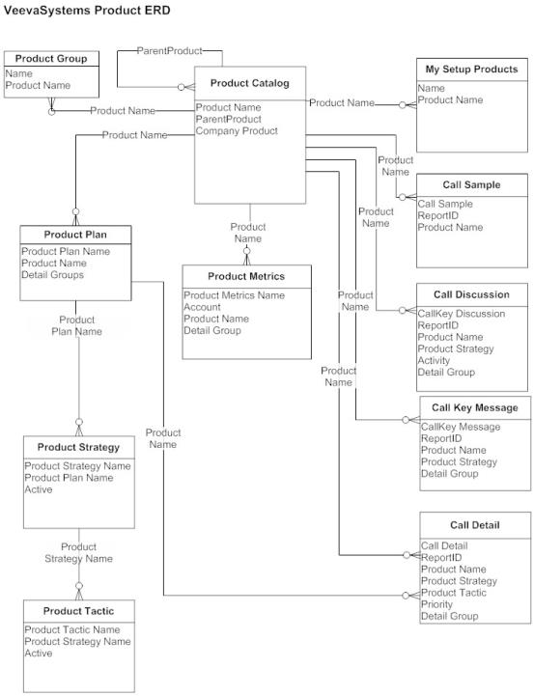
Product Data Model
Products are created in Product Catalog
Products are referenced by other objects
  e.g.
  My Setup
  Call Sample
  Call Discussion
  Call Key Message
  Call Detail

Slide 9
Product Catalog

Slide 10
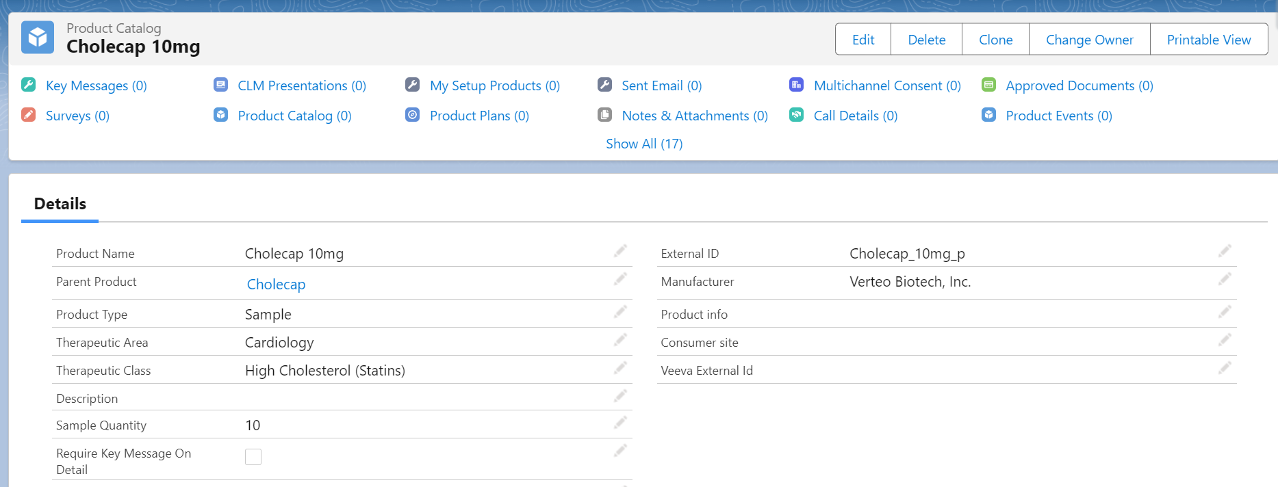
Accessing Product Catalog
Access the Product Catalog from All Tabs > Product Catalog

Slide 11
Product Types
The Product Type (Product_Type_vod__c) determines the use for the product
The main product type in the catalog is Product Detail. All other product types are child of the detail
Detail
For Detailing
For Sample & Promotional
For Order Management
Detail Group.
Detail Topic.
Product Group.
Sample.
Sample Product Group .
BRC.
Promotional Item.
High Value Promotional Item.
Alternative Sample.
Order.
Kit Item.
Inventory Monitoring.

Slide 12
Product Types ... 1
The following is the full list of product types delivered out-of-the-box in VEEVA CRM:
  Detail:
    This type represents the product detailed, or discussed, during sales rep calls against targeted accounts
    Access to the other type of products is driven by alignment of users to the Detail level product, via the My Setup page
    Other types of products (see below) are associated to their parent Detail product, via the Parent Product field
  Sample:
    Represents samples that are disbursed as free products to physicians during calls
    These have specified lot numbers and form factors stored in the Sample Lot object
  BRC:
    Business Reply Cards, or BRCs, represent requests to ship product samples to an HCP
    This provide a mechanism for sales representatives to create sample orders on behalf of a requesting HCP through the VEEVA CRM application
    Users will be able to specify a Ship to Location allowing BRC shipments to be sent to a business location associated to the HCP

Slide 13
Product Types ... 2
  Promotional Item:
    Any non-sample item given to physicians or other targeted accounts free of charge.
    Examples include educational brochures and pamphlets, pens, USB drives, etc.
  Order:
    For products ordered by pharmacies and other institutions.
    These have a monetary value driven by pricing rules defined in the Pricing_Rule_vod object.
  Detail Group:
    This special type is used to represent a group of Detail level products. Unlike other types, this type does not have a detail level product as its parent.
    Detail products that are part of a Detail Group are linked together via the Product Group object.

Slide 14
Product Types ... 3
  Detail Topic:
    Represents a topic of discussion relating to a Detail Group
  Reprint:
    A physical paper copy of information material, such as a Product Information brochure, or Important Safety Information inset
  Alternative Sample:
    A product sample that does not require a lot number for disbursement (e.g.: co-pay cards, vouchers)
    Alternative samples require both a valid license status and an HCP signature
    It should have the Parent_Product_vod field populated with a Detail-level product
  High Value Promotional Item:
    Any highly valued marketing or sales aid requiring an HCP's signature when left at a call location. (e.g.: medical books, models, demonstration devices).
    The Parent_Product_vod field must be populated with a Detail-level product

Slide 15
Product Types ... 4
  Kit Item:
    Items that make up a kit, which is a virtual bundling of two types of products
    Products of type kit item are linked to the kit by setting the parent product to the corresponding kit
    record (product catalog record with Product_Type_vod = Order)
  Product Group:
    Links detail products that are part of a Detail Group
  Sample Product Group:
    An ensemble of samples (products of type Sample or BRC) from the Product Catalog against which specific disbursement limit rules may be defined
    These items are from the same company but may or may not belong to the same brand (products of type detail)
    It is also sometimes referred as Sample Portfolio or Sample Band.

Slide 16
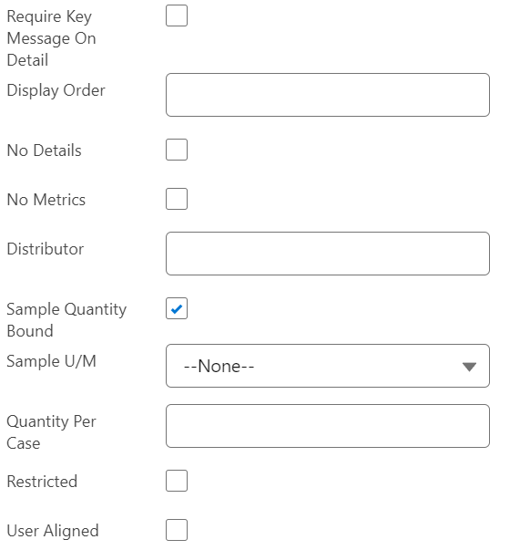
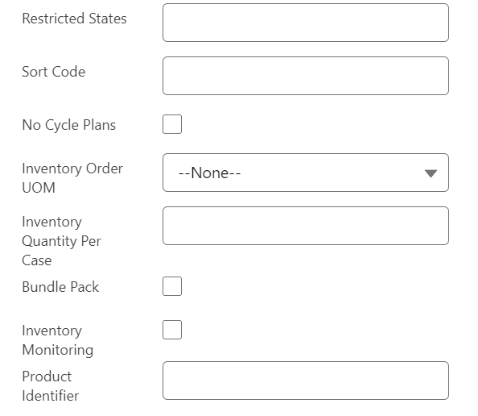
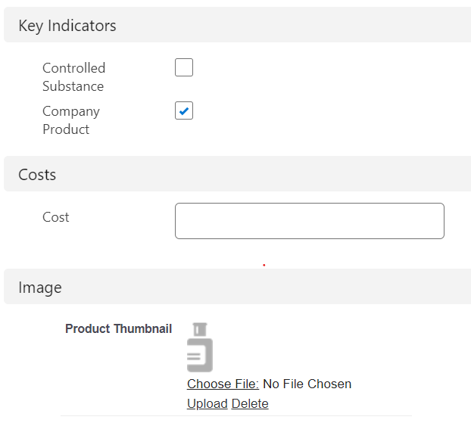
Adding a Detail Product ...1
Key Message: is required when detailing this product
The order to display the product on Call Report
No Details: Exclude product on call report
No Cycle Plans: Exclude product from cycle plan page
No Metrics: Exclude metrics displaying for specific products
Indicates company vs. competitor products

Slide 17
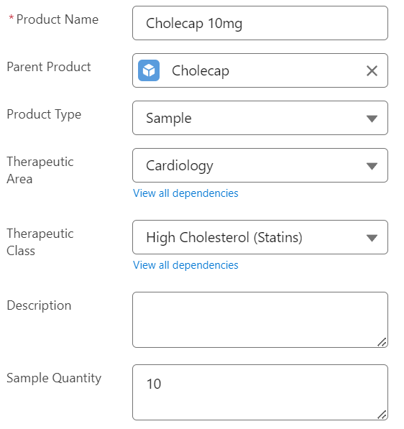
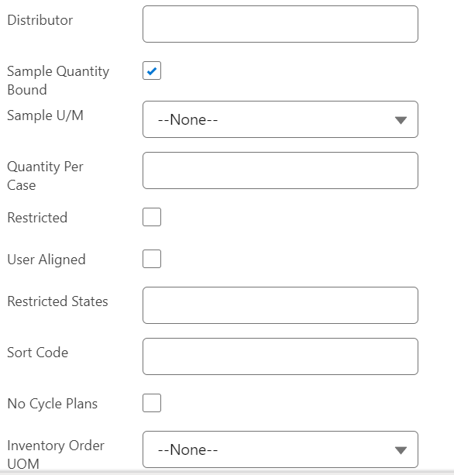
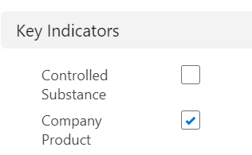
Adding a Detail Product ... 2
Company distributing BRC samples; displayed when capturing signatures
If Product Type is not Detail, it must have a Parent Product of type Detail
Must be checked to enforce Sample Quantity online
To restrict product detailing and sampling of certain products and detail topics by Account.
Restricts the sample quantity entered on the call report; On iRep: only values entered here will appear. If no values, will default to 1-20
User aligned product to provide users a more granular level of product availability
If product is a controlled substance, then dr. must have DEA license for sampling

Slide 18
User-Aligned Products
To provide users a more granular level of product availability, the User-Aligned
functionality may be employed
This functionality allows an organization to determine which specific product records are
available to a user at the child product level, rather than at the parent detail level
To configure the User-Aligned functionality, the following must occur:
  The User_Aligned_vod check box for the product record (BRC, Alternative Sample, High Value Promotional Item, Promotional Item, Reprint, or custom) must be selected in the Product Catalog
  A record must be added directly to the My Setup Product object for the user and product record that is marked user aligned
If a BRC, Alternative Sample, High Value Promotional Item, Promotional Item, Reprint, or custom product record is marked as user-aligned in the Product Catalog, providing a user access to the parent Detail record via My Setup does not cause the product to be available for selection
The specific BRC, Alternative Sample, High Value Promotional Item, Promotional Item, Reprint, or custom product type must be added directly to the My Setup Product object

Slide 19
Restricted Products
Customers have the ability to restrict product detailing and sampling of certain products
and detail topics by Account
To enable this feature:
  Grant users FLS read permissions to the Restricted_Products_vod field on the Account object
  Ensure the field is on the appropriate page layout for that Account
  Populate the field with a double semicolon delimited list of the product and detail topic names that should be restricted. For example: Product 1;;Product 2;;Product 3
  The Restricted_Products_vod field is not required on the Account page layout. To allow users to see which Products are restricted, add the field to the page layout and set it to read only.

Slide 20
My Setup

Slide 21
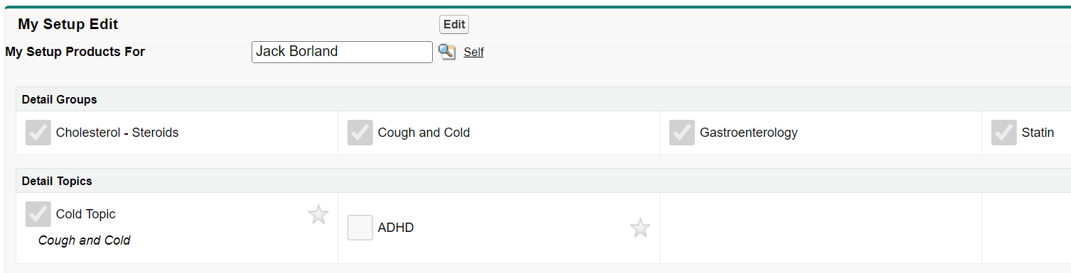
Enabling a Product in My Setup Tab
Identifies products that users:
  Are responsible for promoting
  Can include in Call Reports
  Can track in Product Metrics (company and competitor)
  Can view in Cycle Plans
  Can view in Vinsights
      To add products to users’ My Setup go to:
  All Tabs > My Setup
Users can detail company products that are selected
Selected competitor products appear in Product Metrics

Slide 22

How to add Products to My Setup?
Manually through the My Setup tab
  Preferred if the product mix for each rep changes regularly
Apex Data Loader and/or Workbench –
  Preferred for large number of users and/or products
My Setup table stores one row per product per user

Slide 23
Detail Favorites

Slide 24
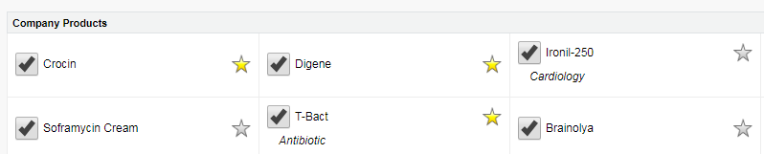
Detail Favorites
Filtering mechanism that lets the user select “favorite” products in My Setup
Useful for field forces with a large number of detail products
  Products marked as “favorites” will display by default on call reports
  Other products in the user’s My Setup can be searched and added to call reports

Slide 25
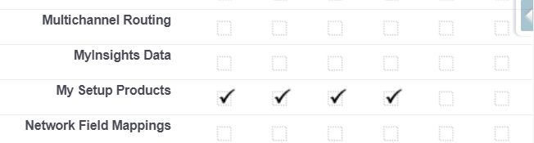
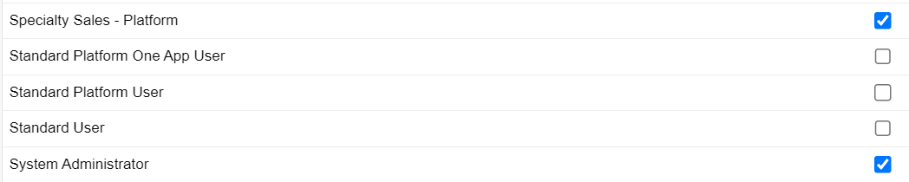
Enabling Detail Favorites
Give user profiles CRUD access to My Setup Products.
  Setup > Manage Users > Profiles and click the link for the desired profile
  Make sure the profile has Read and Edit permission for the My Setup Products
  object
Give user profiles access to the Favorite_vod field in the My Setup Products object:
  Go to Setup > Create > Objects > My Setup Products
  Click the link for the Favorite field
  Click the Set Field-Level Security button
  Select the Visible checkbox for the profiles that need access to the detail favorite functionality

Slide 26
Detail Favorites Management
Users can manage their Favorite products but cannot manage the products
they have access to in My Setup
  My Setup products managed by the Administrator
  Favorite products managed by the User or Administrator

Slide 27
Detail Topics and
Detail Groups

Slide 28
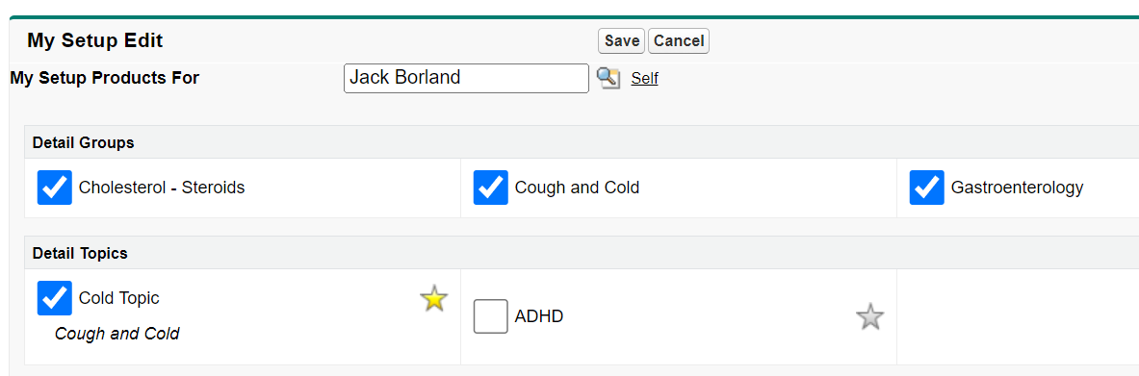
Detail Topics
Detail Topic allows field forces to align topics to targeted Accounts, particularly for
indication based or Animal Health
Detail Topic is a product type in the Product Catalog:
  Behaves similarly to a Detail Product
  Once created it needs to be assigned to users via My Setup
  Detail Topics can be used in Call Reports, Call Discussions, Key Messages, Product Plan and Account Plan Tactics

Slide 29
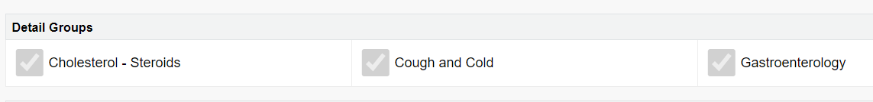
Detail Groups
Detail Groups are used to group Detail Products and Detail Topics based on indication groups, molecules, or species in animal health
  Behaves as another product type
When a Detail group is selected, the products in the group displays in the list of products in My Setup

Slide 30
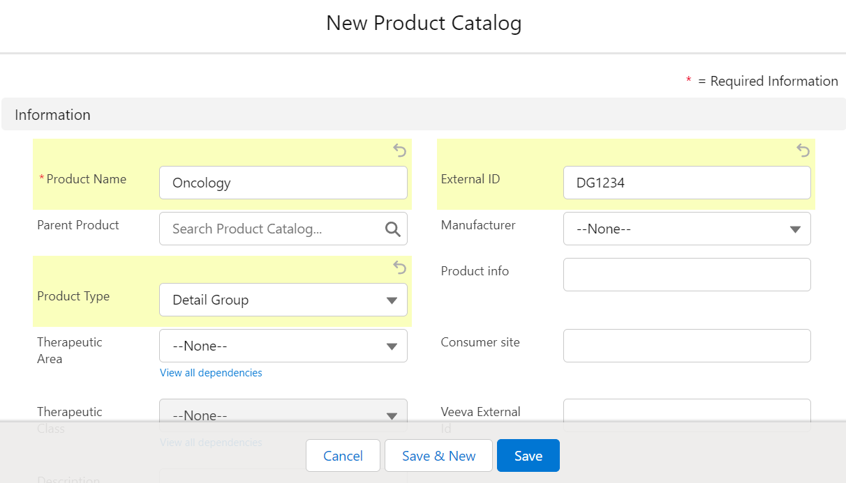
Detail Groups - Define
To define a Detail Group:
  Create a new product in the Product Catalog
  Select the Product Type = “Detail Group”

Slide 31
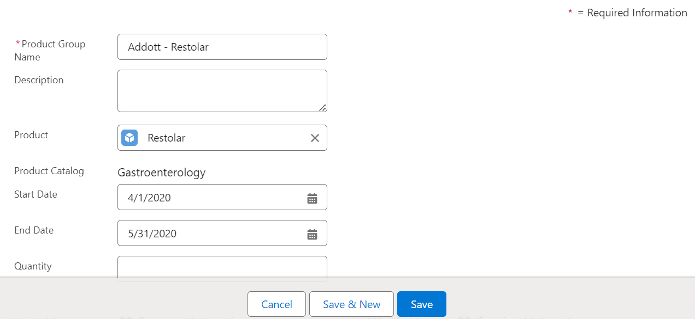
Detail Groups - Assign
To assign products and topics to a Detail Group:
  Select the Detail Group in the Product Catalog
  Add a New Product Group in the Product Groups (Product Catalog) related list
  Enter the Product Group Name
  Use the lookup in the Product field and select a product of type Detail Topic or Detail

Slide 32
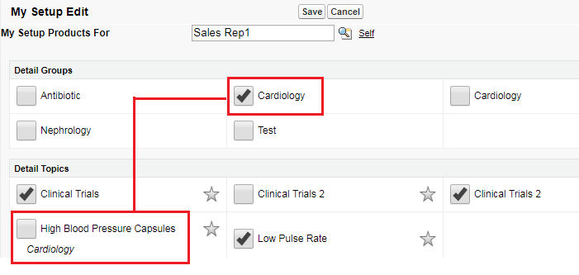
Detail Groups- Display
To display products and topics assigned to a Detail Group, go to My Setup and select the Detail Group checkbox
Otherwise, product and topics tied to a Detail Group will not display in My Setup page

Slide 33
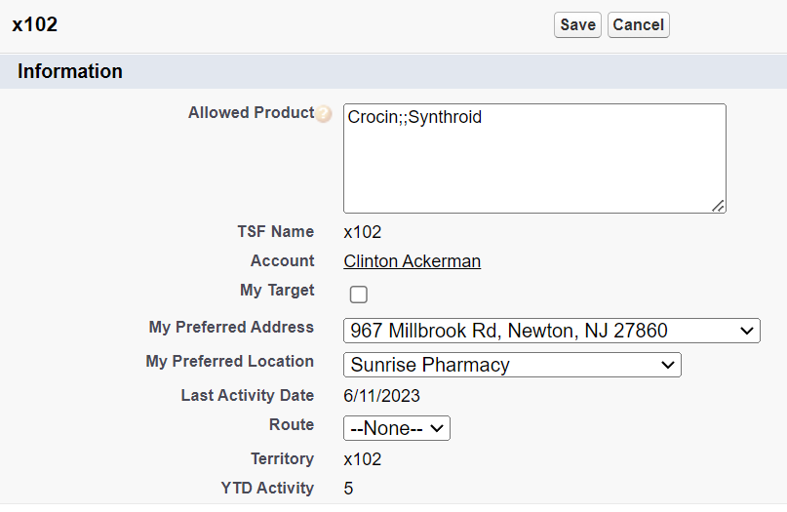
Product Alignment by Territory and Account
Allows control of which products can be detailed by reps (territories) for specific accounts
    Example: When a sales rep is recording a call for a certain account, he can only detail certain products
Typically managed via data loader, not UI
Supported Online, Tablet, iPad
In the Territory Field object, add the Allowed Product field to the TSF Layout page layout
Populate the Allowed Product field with double semi-colon (;;) delimited list of Product Names

Slide 34
Best Practices (if applicable)
Although Product External ID isn’t a mandatory field, it is better to populate this field (especially for Detail products) to maintain data integrity between external system and seamless integration with CLM, Key messages and Approved emails
For Detail type products, it is recommended to populate the Parent Product field where Product is of Market type

Slide 35
Check Your Understanding ... 1
1. You have a Product of Detail type which you want to assign to a sales rep, but this should not be displayed in his detail section of the Call report page.
Which of the following action can be used to achieve this?
Set No Details= TRUE
Change Product Type to Sample
Set User Aligned = TRUE
Populate External ID with ‘1234’
Answer: Set No Details= TRUE
© Cognizant 2023

Slide 36
Check Your Understanding ... 2
2. Detail Groups work similarly to Product Groups for Order Management and Samples, but for Detail-level products.
State True or False
True
False
Answer: True
© Cognizant 2023

Slide 37
Check Your Understanding ... 3
3. Match the Following from My Setup page product assignment:
I. Deselected a. the Topic displays by default in the Call Report and in the Ratings and Evaluations
II. Selected b. the Topic is not visible in the Call Report or the Ratings and Evaluations
III. Selected and Favorite active c. the Topic does not display by default in the Detailing Priority section of the Call report but can be added using the Add other function and searching
I → b; II → c; III → a
I → b; II → a; III → c
I → c; II → c; III → b
I → a; II → b; III → c
Answer: I → b; II → c; III → a
© Cognizant 2023

Slide 38
Check Your Understanding ... 4
4. The My Setup Products object can be prepopulated during implementation to preselect certain products for certain users. This is especially useful if all the users of the application focus on the same product set.
State True or False
True
False
Answer: True
© Cognizant 2023

Slide 39
Check Your Understanding ... 5
5. To enable the Product_Identifier_vod field, we should provide the necessary FLS in the following objects:
Product_vod
Order_Line _vod
Contract_Line _vod
All of the above
Answer: All of the above
© Cognizant 2023

Slide 40

Summary
In this module, you have learnt to:
  Describe the Products Data Model
  Create and Configure Products:
    Product Catalog
    My Setup
    Detail Favorites
    Detail Topics
    Detail Groups

Slide 41

Source
For further details please visit https://crmhelp.VEEVA.com/doc/Content/Home.htm and navigate to Help Topics > Products
Disclaimer: Parts of the content of this course is based on the materials available from the Web sites and books listed above. The materials that can be accessed from linked sites are not maintained by Cognizant Academy and we are not responsible for the contents thereof. All trademarks, service marks, and trade names in this course are the marks of the respective owner(s).

Slide 42
Coming Next ...
In the upcoming module - Sphere of influence, Affiliation, Account Hierarchy you will learn to:
  Describe Product Metrics
  Describe types of Metric fields
  Configure of Product Metrics section on Account profile
  Create new Product Metrics
  Create Metric Configuration
  Explain how users can control Metric on Account Profile
© Cognizant 2023

Slide 43
Thank you
  You have successfully completed
  Products & My Setup

